Slide 1



I'
Go gle | recursion
 | 0. All !';;! Imagos fl &oles Maps ell """' | !Mew> | Selt#!gS | Tools
 | Aboul 47.200 000 rewtts lO J7 seconcts)
 | Did you mean:recursion
Go gle
recursion
0. All
!';;! Imagos
fl &oles
Maps ell """'
!Mew>
Selt#!gS
Tools
Aboul 47.200 000 rewtts lO J7 seconcts)
Did you mean:recursion
If we search Recursion,Google will advised the same Recu rsion search

Slide 2
Advantages of
us1• n Rec u rsion
Recursive functions moke the code look clean and elegant
A complex task con be broken down into
Sequence generation is easier with recursion than using some nested iteration
simple.r sub-prob. lems
using recursion

Slide 3


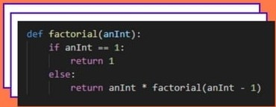


-·
Factorial
Example use of Recursion
·-

Slide 4







i..t'l\TARE 'l!Xl
().I?
1R'llNGTD FIX 11£. PRtQD1S I
. . .
CRfJl1EI> \J£N ITRS)lll F"IX
o:
Tri( PAXlD15 ICJIEATED l,.ttil
I-mEDlb FIXTriE
ICfttl1U> U1E}l ...
)
• •
• •
0 . .
Otherwise.function does some requ ired

Slide 5


Recursion is a programming pattern that is useful in situations when a task can be naturally split into several tasks of the same kind, but simpler. Or when a task can be simplified into an easy action plus a simpler variant of the same task. Or, as we'll see soon, to deal with certain data structures.
W hat • 5 1 Recu rsion?
•
In other words.When a function solves a task, in the process it can call many other functions. A partial case of this is when a function calls itself. That's called recursion.

Slide 6








